Slide 1
Adapter
In Android, Adapter is a bridge between UI component and data source that helps us to fill data in UI component.
It holds the data and send the data to an Adapter view then view can takes the data from the adapter view and shows the data on different views like as ListView,GridView, Spinner etc.

Slide 2
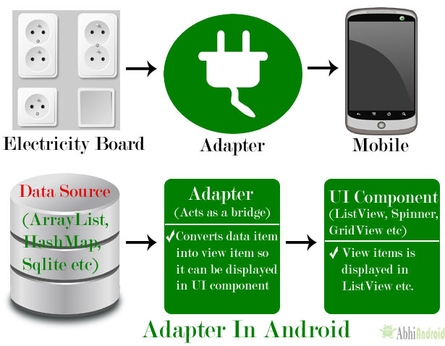

Slide 3
Adapters In Android:
There are the some commonly used Adapter in Android used to fill the data in the UI components.
BaseAdapter – It is parent adapter for all other adapters
ArrayAdapter – It is used whenever we have a list of single items which is backed by an array
Custom ArrayAdapter – It is used whenever we need to display a custom list
SimpleAdapter – It is an easy adapter to map static data to views defined in your XML file
Custom SimpleAdapter – It is used whenever we need to display a customized list and needed to access the child items of the list or grid

Slide 4
BaseAdapter In Android:
BaseAdapter is a common base class of a general implementation of an Adapter that can be used in ListView, GridView, Spinner etc.
Whenever we need a customized list in a ListView or customized grids in a GridView we create our own adapter and extend base adapter in that.
Base Adapter can be extended to create a custom Adapter for displaying a custom list item.
ArrayAdapter is also an implementation of BaseAdapter.

Slide 5
ArrayAdapter In Android
Whenever we have a list of single items which is backed by an Array, we can use ArrayAdapter.
ArrayAdapter(Context context, int resource, int textViewResourceId, T[] objects)
ArrayAdapter is more simple and commonly used Adapter in android.
Whenever you have a list of single type of items which is backed by an array, you can use Array Adapter.
For instance, list of phone contacts, countries or names.

Slide 6
Array Adapter
ArrayAdapter(Context context, int resource, int textViewResourceId, T[] objects)
context:
The first parameter is used to pass the context means the reference of current class.
Here this is a keyword used to show the current class reference.
We can also use getApplicationContext(), getActivity() in the place of this keyword. getApplicationContext() is used in a Activity and getActivity() is used in a Fragment.
Resource ID
resource id used to set the layout(xml file) for list items in which you have a text view.
textViewResourceId:
textViewResourceId which is used to set the id of Text View where you want to display the actual text
objects:
An array of objects, used to set the array of elements in the textView. We can set the object of array or array list here.
String animalList[] = {"Lion","Tiger","Monkey","Elephant","Dog","Cat","Camel"};
ArrayAdapter arrayAdapter = new ArrayAdapter(this, R.layout.list_view_items, R.id.textView, animalList);

Slide 7
Autocomplete Text View
AutoCompleteTextView is a view that is similar to EditText, except that it shows a list of completion suggestions automatically while the user is typing.
The list of suggestions is displayed in drop down menu.
The user can choose an item from there to replace the content of edit box with.
Android AutoCompleteTextView is the subclass of EditText class.

Slide 8
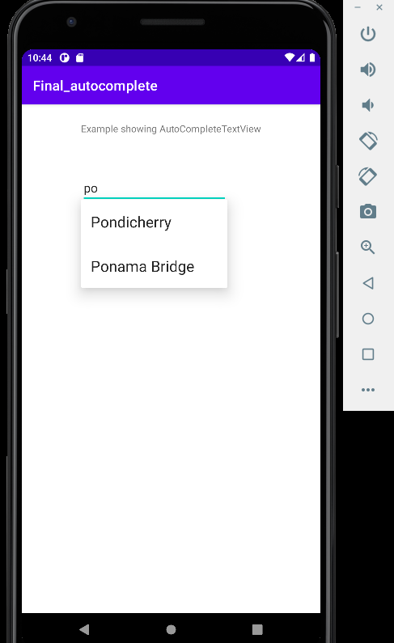
Example

Slide 9
Example
<?xml version="1.0" encoding="utf-8"?> <RelativeLayout xmlns:android="http://schemas.android.com/apk/res/android" xmlns:tools="http://schemas.android.com/tools" android:layout_width="match_parent" android:layout_height="match_parent" tools:context=".MainActivity" > <TextView android:id="@+id/textView2" android:layout_width="wrap_content" android:layout_height="wrap_content" android:layout_alignParentTop="true" android:layout_centerHorizontal="true" android:layout_marginTop="25dp" android:text="@string/example_autocompletetextview" /> <AutoCompleteTextView android:id="@+id/autoCompleteTextView1" android:layout_width="wrap_content" android:layout_height="wrap_content" android:layout_alignLeft="@+id/textView2" android:layout_below="@+id/textView2" android:layout_marginTop="54dp" android:ems="10" /> </RelativeLayout>
String.xml
<resources> <string name="app_name">Final_autocomplete</string> <string name="example_autocompletetextview">Example showing AutoCompleteTextView</string> </resources>

Slide 10
Example
package com.example.final_autocomplete; import androidx.appcompat.app.AppCompatActivity; import android.os.Bundle; import android.widget.ArrayAdapter; import android.widget.AutoCompleteTextView; public class MainActivity extends AppCompatActivity { AutoCompleteTextView autocomplete; String[] arr = { "Pondicherry", "Param","Ponama Bridge","pala,", "Pastatestates"}; @Override protected void onCreate(Bundle savedInstanceState) { super.onCreate(savedInstanceState); setContentView(R.layout.activity_main); autocomplete = (AutoCompleteTextView) findViewById(R.id.autoCompleteTextView1); ArrayAdapter<String> adapter = new ArrayAdapter<String> (this,android.R.layout.select_dialog_item, arr); autocomplete.setThreshold(2); autocomplete.setAdapter(adapter); } }

